Slide 1
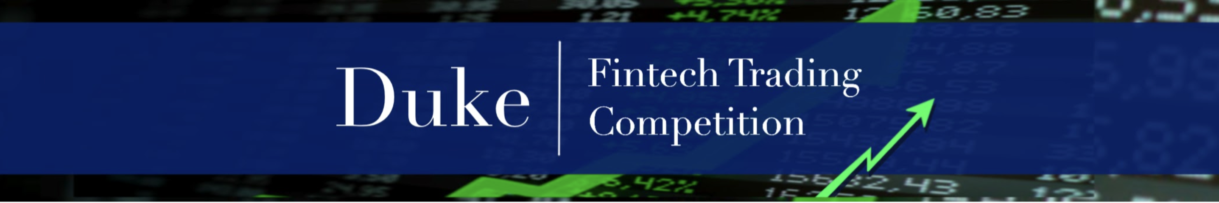
Scoring & Ranking

Slide 2
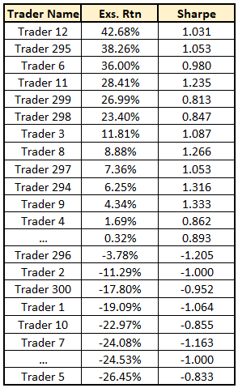
Start:
Calculate Excess Return and Volatility for each trader in the competition.
Performed daily as data are available
Based on end-of-day Net Asset Value (NAV) starting on 01 Oct 2023
See the “Calculating Excess Return, Volatility and Sharpe” page under “Scoring” for details.

Slide 3
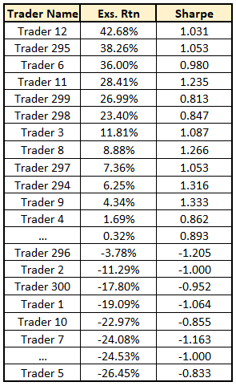
Step 1:
Sort the traders by decreasing excess return.

Slide 4
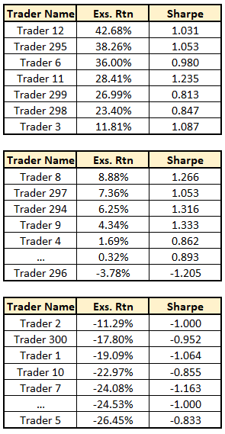
Step 2:
1st Bracket
Break traders into n brackets
2nd Bracket
nth Bracket

Slide 5
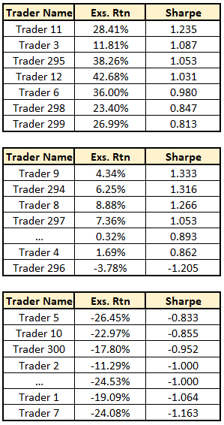
Step 3:
1st Bracket
Sort by Sharpe (decreasing) within each bracket
2nd Bracket
nth Bracket

Slide 6
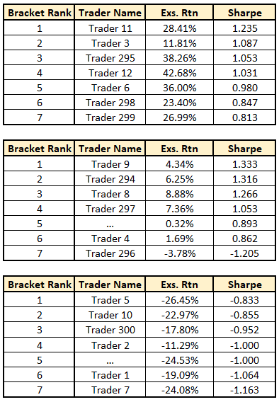
Step 4:
1st Bracket
Assign ranks within brackets
(your “bracket rank”)
2nd Bracket
nth Bracket

Slide 7
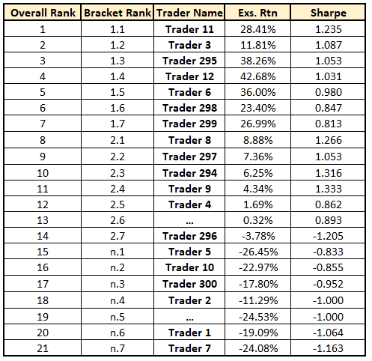
Step 5:
Recombine and assign overall rank
→ The “overall rank” is your rank for the entire competition.

Slide 8
Useful Properties of this system:
Traders are rewarded for returns, but penalized for volatility
Cash prizes are only awarded to the top half of the top bracket
To get into the top bracket, you need a high return
But to place highly in the top bracket, you need a low vol!
Bracket system keeps traders competing
Even if you can’t win overall, you can chase top spots in your bracket

